Slide 1







StayTech
Retail Sales Highlights
Using Python
Akshat Bansal Mann Chavda Meet Dave Heman Darji Meet Vastani

Slide 2




Introduction
StayTech
Objective
Understand sales fluctuations across months and years.
Identify key revenue trends over time.
Highlight top-performing products in terms of sales and revenue.
Dataset
Retail sales data (e.g., CSV file with sales, revenue, date, product).

Slide 3
Seasonal Sales Patterns Overview
StayTech
Key Insights
How sales change month by month.
Identifies peak sales periods.
Helps businesses anticipate inventory needs and promotional opportunities.
Grouping
Sales data grouped by month and year for better seasonal understanding.

Slide 4
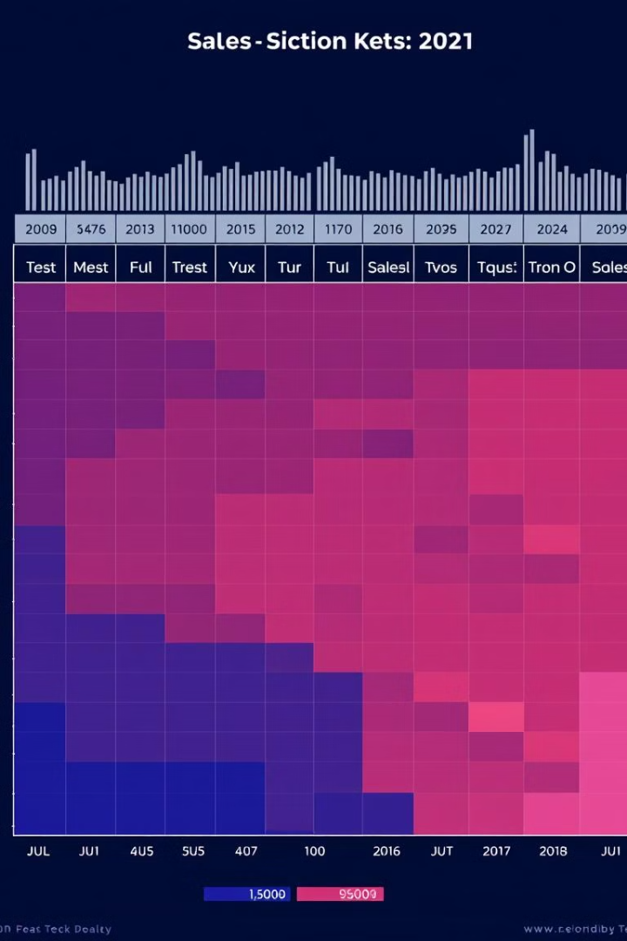
Heatmap of Seasonal Sales Patterns
StayTech
Heatmap: Monthly Sales Across Years
Visualization: Heatmap displaying sales per month across different years.
Color Representation:
o Darker colors show lower sales.
o Brighter colors highlight higher sales periods.
Insight: Clearly identifies months with consistently high sales across years.

Slide 5
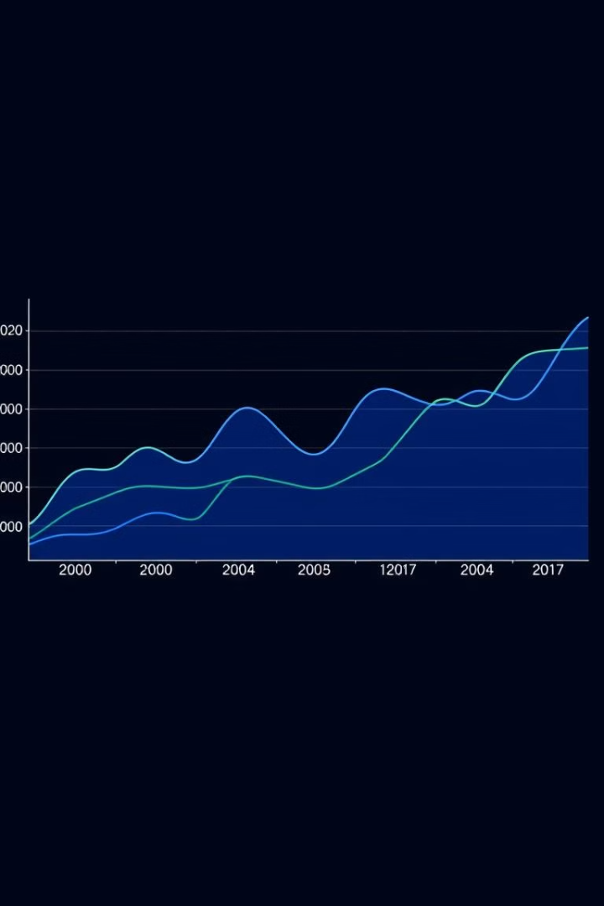
Revenue Trends Overview
StayTech
Revenue Trends Over Time
Objective: Understand how revenue varies over months and years.
Analysis:
o Group revenue data by month and year.
o Track performance over time to observe revenue peaks or declines.
Importance: Helps forecast future revenue trends and business planning.

Slide 6
Revenue Trends Line Chart
StayTech
Monthly Revenue Trends by Year
Visualization: Line chart showing revenue trends month-by-month.
Key Insight:
o Comparison of revenue across different years.
o Highlights months with revenue peaks and declines.
Observation: Notable fluctuations due to seasons, events, or promotions.

Slide 7
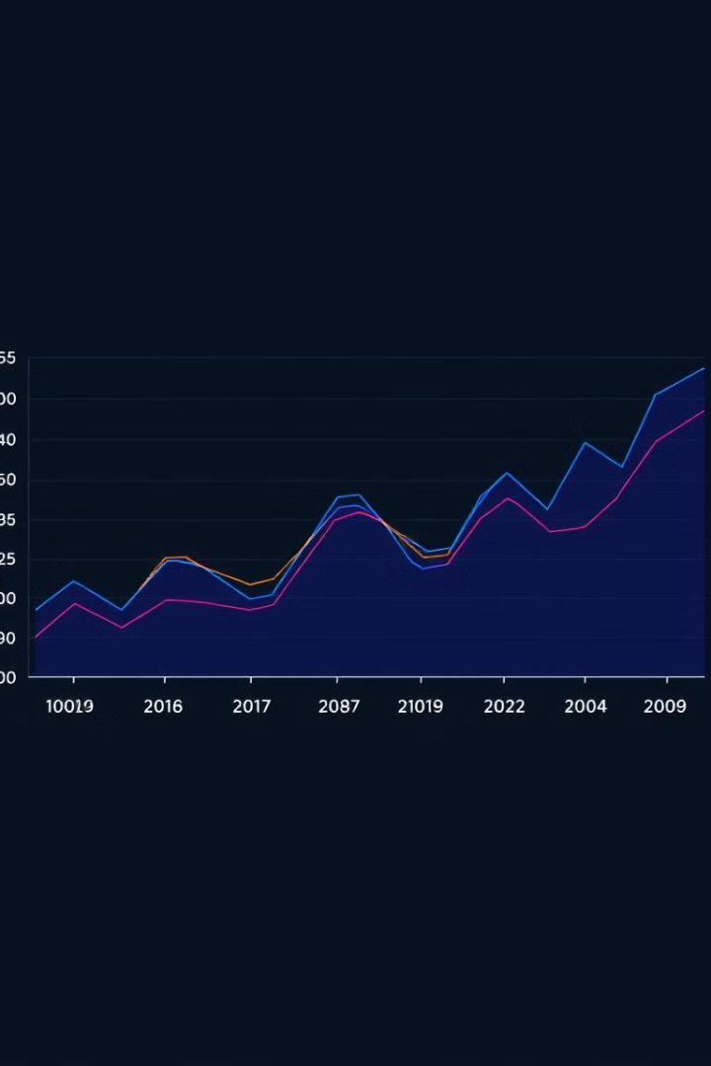
Top Products Overview
StayTech
Identifying Top Products
Objective: Analyze the top-performing products in terms of sales and revenue.
Grouping: Sales and revenue grouped by product name.
Importance: Helps identify best-sellers and high-revenue generators for strategic focus.

Slide 8
StayTech
Top 10 Products
By Sales:
By Revenue:
Visualization: Bar chart showcasing the top 10 products by total sales volume.
Key Insight: Products that generate the highest sales volume.
Observation: Identify which products are consistently popular with customers.
Visualization: Bar chart displaying the top 10 products by total revenue
Key Insight: Products contributing the most revenue, which may differ from top sales.
Observation: High-revenue products may have higher prices or margins.

Slide 9
Conclusion & Recommendations
StayTech
Summary of Findings
Seasonal Patterns: Identify key months for peak sales and revenue.
Revenue Trends: Track yearly trends to plan for sales fluctuations.
Top Products: Focus on promoting high-revenue and high-sales products.
Recomendations
Optimize inventory for high-demand months.
Focus marketing efforts on top-selling products during peak seasons.
Analyze underperforming products for potential improvements.

Slide 10
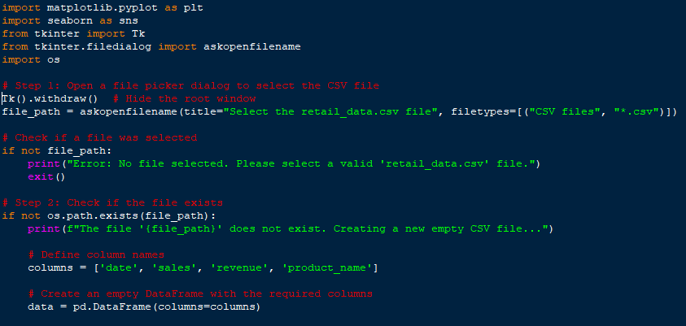
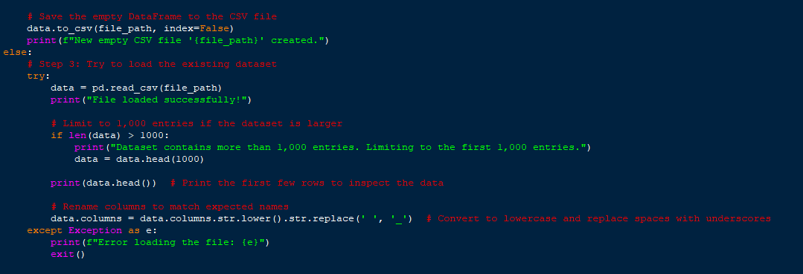
ö
Source Code
StayTech

Slide 11
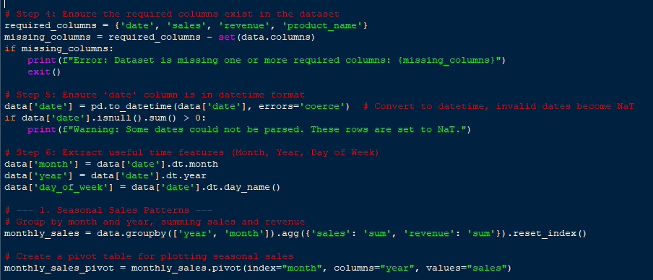
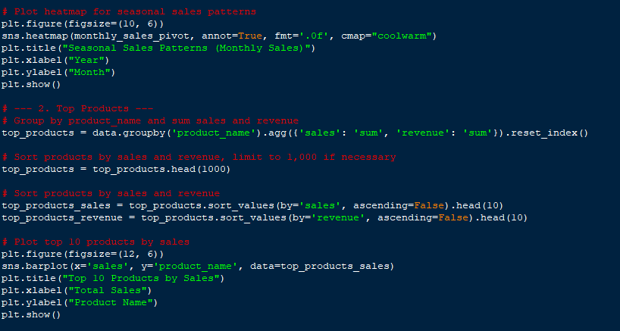
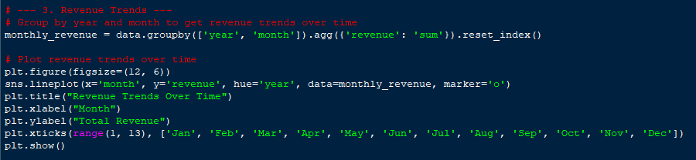
Source Code
StayTech

Slide 12
StayTech
THANK YOU

